Slide 1
SHADOW REMOVAL
Using Image Processing
CASE STUDY

Slide 2
CONTENTS:
AIM
Problem Statement
Introduction
Original vs Processed image
Basic Approach Of Shadow Removal
Algorithms used
Results
Conclusion
References

Slide 3
AIM:
The aim of this project is to detect and remove shadows in still images

Slide 4
Problem Statement:
Why Shadow Removal?
Shadow detection and removal is important since ignoring the existence of shadows may result in serious problems like reducing the reliability of many computer vision algorithms, object merging, object lose, misinterpretation and alteration of object shape in various visual processing applications like segmentation, scene analysis and tracking.

Slide 5
Introduction
Shadow detection and removal is an important task when dealing with colour outdoor images. Shadows are generated by a local and relative absence of light.
Shadows are, first of all, a local decrease in the amount of light that reaches a surface.
Secondly, they are a local change in the amount of light rejected by a surface toward the observer. Most shadow detection and segmentation methods are based on image analysis.
However, some factors will affect the detection result due to the complexity of the circumstances, like water and a low intensity roof because of the special material as they are easy mistaken as shadows.
Shadow removal from respective image can be used for object detection, such as cancer detection, military object detection etc.

Slide 6
TYPES OF SHADOWS:
Shadows can be broadly classified as self-shadows and cast shadows.
Self-shadow is the shadow cast by an object on itself. This kind of shadow appears on an object when direct light from a source is unable to reach that area of the object.
Cast shadows are the shadows formed by an object on another object or surface. These shadows have two main regions when the scene is illuminated by multiple light sources.
The dark inner region in cast shadow is called umbra, and the light outer region is called penumbra.

Slide 7
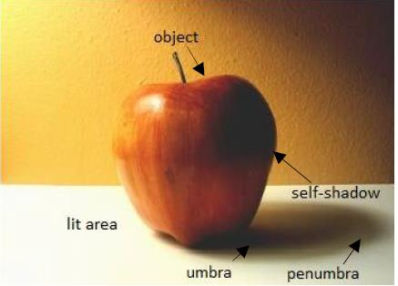
.
.

Slide 8
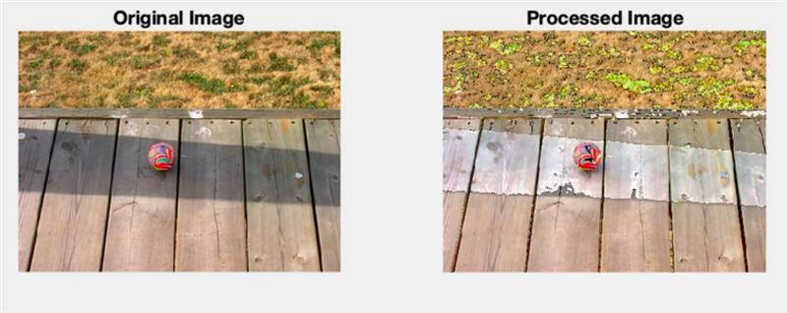
Image Before and After
Shadow Removal

Slide 9
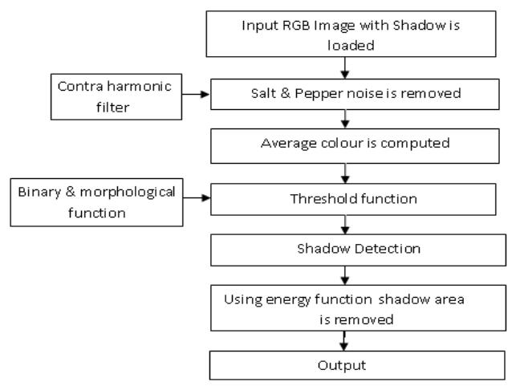
Basic Approach of Shadow Removal: (Flowchart of algorithm used)

Slide 10
VARIOUS STEPS PERFORMED:
Contraharmonic Filters
RBG Colour Model
Hypothesis Test
Energy Function

Slide 11
CHALLENGES IN SHADOW REMOVAL:
Preserve the texture beneath the shadow.
Retain the color information of the surface.
Make the shadow edges unnoticeable in the shadow-free image .
Reduce visual artifacts.
Consume less time since shadow removal is dealt with as a preprocessing task.

Slide 12
SHADOW REMOVAL TECHNIQUES:
A. Reintegration method
B. Relighting method
C. Patch-based method
D. Color transfer method
E. Interactive method

Slide 13
.
A. Reintegration Method:
The reintegration methods for shadow removal are built on the concept that nullifying the image gradient along the shadow edges and integrating back the modified gradient will produce a shadow-free image.
B. Relighting Methods:
Shadow regions appear in an image due to a reduction in the amount of light reaching the area compared to the non-shadow regions.

Slide 14
.
C. Patch- based Method:
The patch-based methods for shadow removal attempt to operate on patches rather than on single pixels.
D. Color Transfer Method:
This method aims at transferring color information from the lit areas to the shadow areas. The colors from the lit regions are transferred to shadow regions using mean and standard deviation of the Gaussian distribution followed by the color intensities in an image

Slide 15
.
E. Interactive Method:
The interactive techniques for shadow removal are generally simpler than the automated techniques since the user can provide useful cues for locating the shadows in an image. It’s iteratively interact with the removal system there by deriving a shadow-free image.

Slide 16
Result:
The shadow pixels that belong to a corresponding colour are isolated and removed. In this work first preprocessing of image is done by filtering the image using contraharmonic filter where pepper noise is removed. Then, average colour values of red, green,blue (primary) components in image are obtained which are considered dark pixels as of shadow regions. Then hypothesis test is used to detect the shadow and shadows are detected by comparing average R, G and B values with original R, G and B values of image. After shadows are detected then shadow removal is done by using energy function.

Slide 17
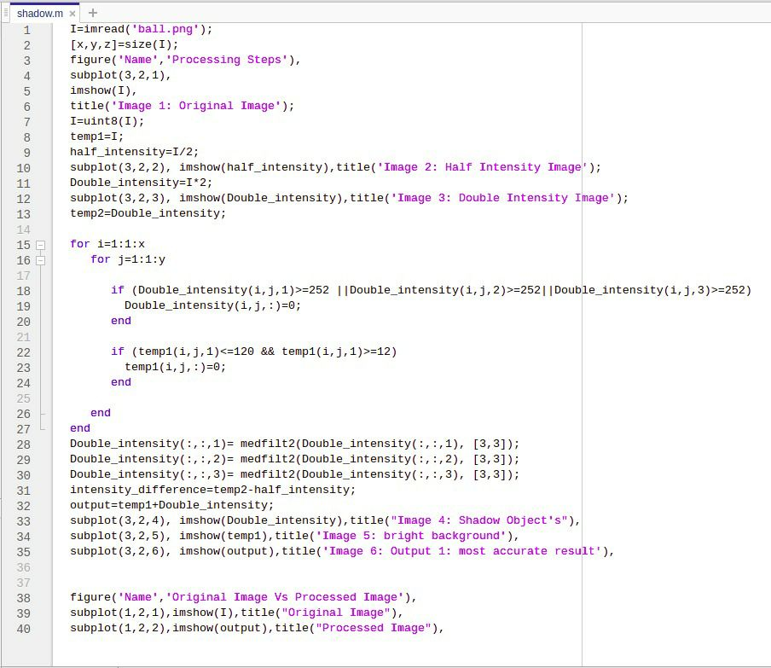
Implementation:
.

Slide 18
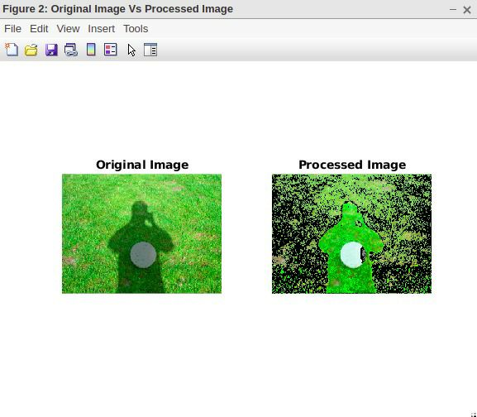
Output:
.

Slide 19
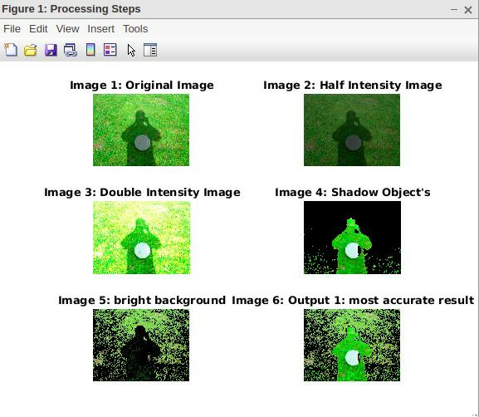
.
.

Slide 20
Conclusion:
The algorithm allows for the removal of a large percentage of shaded colours. This shows that it is possible to remove shadow from image without losing a large amount of pertinent data.

Slide 21
REFERENCES:
https://www.researchgate.net/publication/50346386_SHADOW_DETECTION_AND_REMOVAL_IN_COLOUR_IMAGES_USING_MATLAB
https://www.researchgate.net/publication/311487566_A_Survey_on_Shadow_Removal_Techniques_for_Single_Image

Slide 22


